Slide 1
The best location to open an Italian Restaurant in New York City
Project carried out for Applied Data Science Capstone course

Slide 2
Introduction
The business problem under discussion is the following one: Which is the best place to open an Italian Restaurant in New York City (NYC)?
Clearly the answer to the above question is not trivial and it should be the result of a careful evaluation that the business owner should make.
The problem may be of interest for anybody who wants to start the above business activity and would like to select the best location to start it.

Slide 3
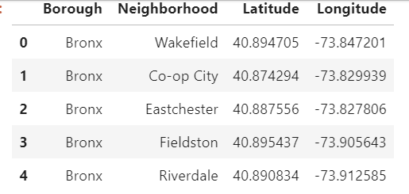
Data 1/2
The data used for this report are the geographical data of NYC, in particular the data set used during the Course laboratories and contained in the file “newyork_data.json”.
NYC data set contains a list of neighborhoods which include Boroughs, Neighborhoods along with a position described by geographical coordinates (i.e. Latitude and Longitude).

Slide 4
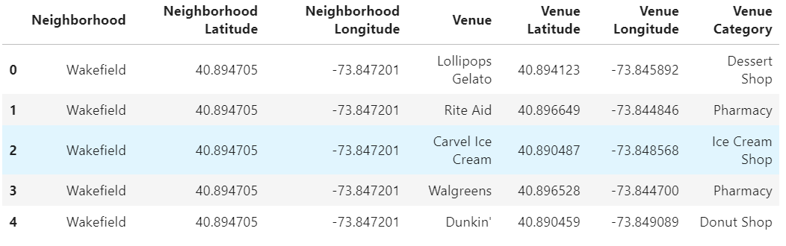
Data 2/2
Through these data, using the Foursquare API, it’s possible to explore neighborhoods and get a picture of the venues for each neighborhood.
This allows to make an analysis which is propaedeutic to the evaluation of the best place to start the business activity.

Slide 5
Methodology 1/5
The methodology used for this project is based on the following elements:
Preparation and analysis of data set
Use of Foursquare API to explore neighborhoods in the City
Analysis of each Neighborhood through Pandas
Definition of the Features for the choice of the best location to open an Italian Restaurant in NYC.
Selection of the best location

Slide 6
Methodology 2/5
For what concerns point 1, the reference data set is the one used for the course laboratory, named “newyork_data.json”, and concerns neighborhoods of NYC. It can be download and conveniently transformed into a pandas dataframe.

Slide 7
Methodology 3/5
It’s then possible to go to point 2 of the procedure, i.e. use of Foursquare API to explore neighborhoods in the City. This means that, for each neighborhood, a number of venues is found within a certain radius. Both the number of venues and the radius can be set as parameters. For this project, the number of venues and radius have been set to 100 and 500 m respectively.

Slide 8
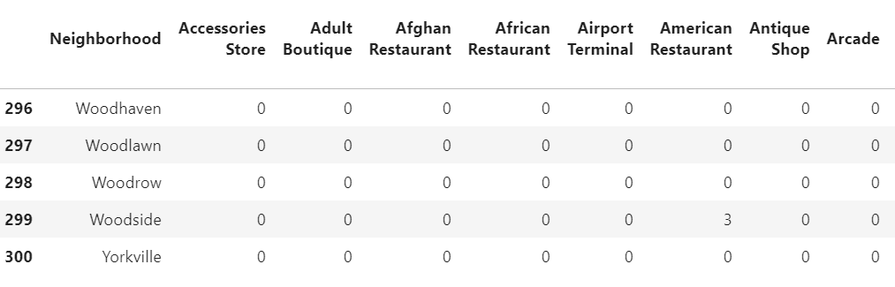
Methodology 4/5
After that, all data are first hot-encoded and then grouped for Neighborhood, therefore the resulting dataframe will have each row representing a neighborhood and the columns the venue category. The data are the number of venues falling into that category.

Slide 9
Methodology 5/5
The neighborhoods list must be filtered according to some criteria which have been identified as follows:
No Italian Restaurant already existing
At least one bus stop or one metro station
At least one entertainment venue belonging to the following categories:
Theater
Comedy Club
Art Gallery
Art Museum
Museum
Music Venue
Jazz Club
Concert Hall

Slide 10
Results 1/2
After filtering out the neighborhoods according to the above requirements, in order to make the final choice of the location where it’s better to open an Italian Restaurant, two further columns (“Transportation” and “Entertainment”) have been added to the dataframe and put at the beginning of it.
“Transportation” column contains the sum of bus stop and metro station whereas “Entertainment” contains the sum of entertainment venues (i.e. Theater, Comedy Club, Art Gallery, Art Museum, Museum, Music Venue, Jazz Club, Concert Hall).
The criterion used to select the optimal neighborhood is the presence of transportation facilities, as they have been considered with higher weight than the Entertainment venues.

Slide 11
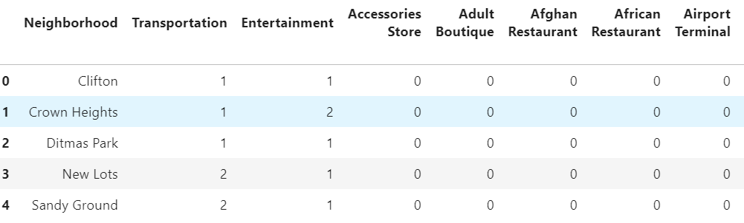
Results 2/2
After filtering the neighborhood data according to the criteria defined in the previous section, the resulting data frame is the one shown in the next figure:
According to the figure, only five candidates still remain. However, two neighborhoods (New Lots and Sandy Ground) have more transportation means than the remaining ones. In particular, New Lots has both a bus stop and a metrostation, that’s why it has been considered more suited than the other candidate neighborhoods.

Slide 12
Discussions
Final selection of the best location to open an Italian Restaurant in NYC has been done on the basis of a set of criteria introduced to select the preferred neighborhood.
The used methodology can obviously lead to different results in case different criteria are used.
It has been set as a constrained optimization problem where the constraints were the requirements to be satisfied while the objective function was the feature considered to select the optimum neighborhood.
Different criteria could in any case be defined and, as a result, different locations could be considered the best one to open an Italian Restaurant in NYC.

Slide 13
Conclusions
An analysis based on location data has been carried out.
The goal of the analysis was the identification of the best location in NYC where to open an Italian Restaurant.
The problem has been stated and the source of data has been described. The methodology has been explained in detail and all the steps of the procedure have been highlighted.
Finally, results have been presented along with some remarks.
Starting from a data set containing the Neighborhood of NYC, the source of data for the analysis came from Foursquare API, which allowed to get a given number of venues within a predefined radius for each neighborhood.
Venues and their categories have been used to define some criteria needed to select the neighborhood candidates for the final choice and, subsequently, to select the most suited neighborhood to open an Italian Restaurant on NYC.

